Slide 1
Analysis of Top 10 Prolific Goalscorers Between 2010-2022
Presented by
Akshit Naithani - B208
Vrishin Jain - B235

Slide 2
Introduction
Football is probably the oldest and the most famous sport in the world.
There have been many legendary players throughout its history who are well recognised for their talents and the joy they provided to the world.
Some of them include players like Diego Maradona, Pele, Gerd Muller, Paolo Maldini, Franz Beckenbauer, Ronaldinho, Marco Van Basten, Andriy Shevchenko, Lionel Messi, Cristiano Ronaldo, etc.
Today we are going to be looking at some Prolific Goalscorers and take a look at their in-depth stats and what makes them great.

Slide 3
Why This Data-Set ?
Since statistics were not that famous earlier and due to lack of technology, stats was kept to just goals and assists of a player.
The players then bought were judged by these two stats along with the eye test.
This is the reason we took the time of this decade since there was no earlier data available before the 2000s.
Nowadays every stats of a player is stored and taken into account while buying or selling him or even at contract renewals.

Slide 4
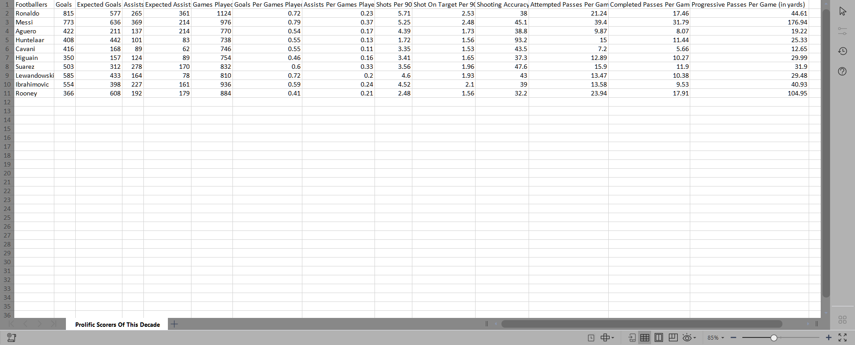
Data-Set:

Slide 5
Attributes Descriptions
Goals - Total amount of goals scored by the player in their careers
Expected Goals - Amount of goals excepted to be scored by the player in their careers
Assists - Amount of passes completed by the player to their team-mate which leads to a goal
Excepted Assists - Amount of assists excepted to be given by the player in their careers
Games Played - Amount of games played by the player in their careers
Goals Per Games Played - Average goals scored per match they played
Assists Per Games Played - Average assists given per match they played

Slide 6
Attributes Descriptions
Shots Per 90 - Amount of shots taken in a match
Shots on target per 90 - Amount of shots that were going towards the goal
Shooting Accuracy (in %) - Higher the accuracy, more accurate towards the corners of the goal posts which makes it harder to save
Attempted Passes per game - Passes attempted by the player in a match
Completed Passes Per Game - Passes that were actually received by their team-mates in a match
Progressive Passes Per Game (in yards) - Distance the ball covered towards the opponent's goal when the player passed the ball in a match

Slide 7
Analysis Of The Goalscorers
There are some very basic statistics done as well as some advanced charts that will show us the in depth statistics of these players to us and we’ll analyse and see why they are one of the greatest players.
We’ll also showcase some comparison of the GOATs Cristiano Ronaldo and Lionel Messi with the players in the making Erling Haaland and Kylian Mbappe.

Slide 8
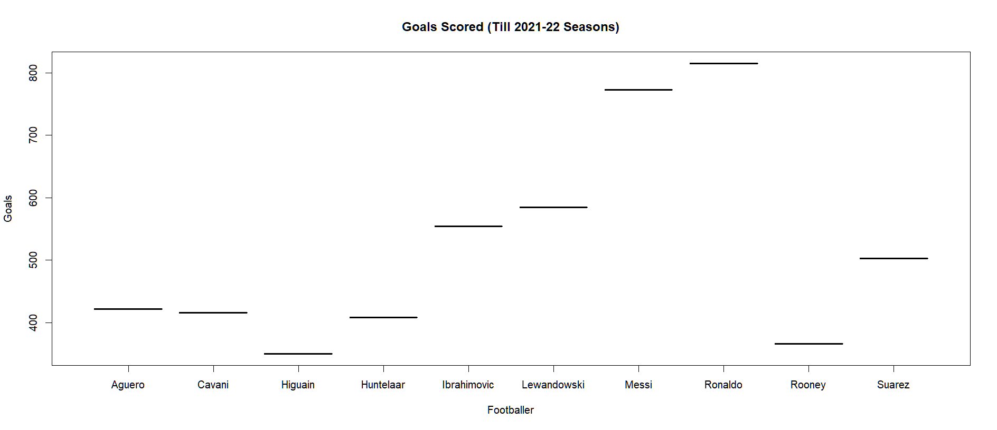
Goals

Slide 9
Analysis
As we can see Cristiano has scored the most goals here followed closely by Lionel Messi. Higuain has scored the least.
Not much can be interpreted here since this is a raw showcase of their goal scoring ability.

Slide 10
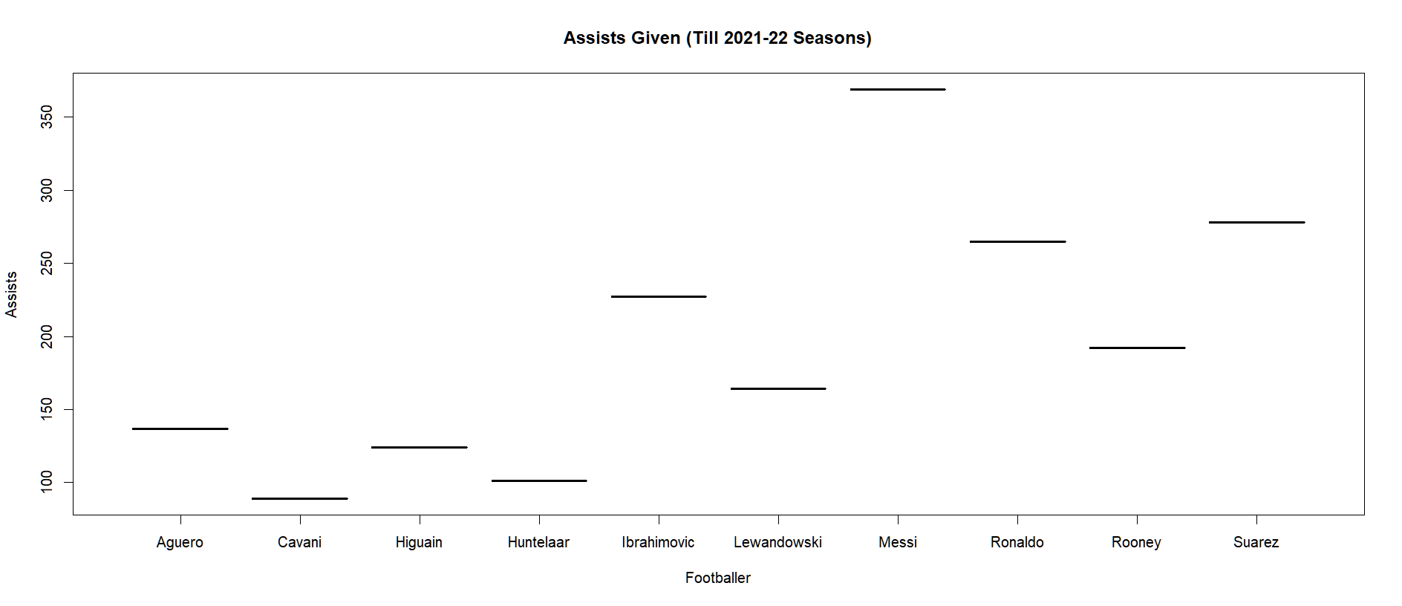
Assists

Slide 11
Analysis
Messi has the most assists, about 100 more than Suarez and Ronaldo. It makes sense since he is a playmaker and has excellent passing ability which we will see in the upcoming slides. Both Roanldo and Messi being best and 2nd best goalscorers and 3rd best and best assist providers respectively shows how why they are two best players in the last two decades.
Cavani here has the least assists here, under 100, since he is a proper striker who waits around in the box to finish a chance. He is also the 8th highest goalscorer which illustrates that he was always relied to finish a chance which was made by the team.

Slide 12
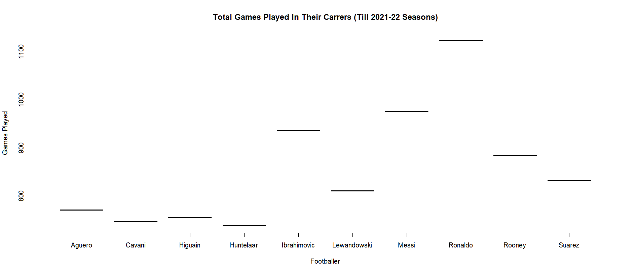
Games Played

Slide 13
Analysis
Not much to analyse just gives a good idea about their fitness and injury records. Ronaldo has played over 1100 games which shows how excellent his fitness is.

Slide 14
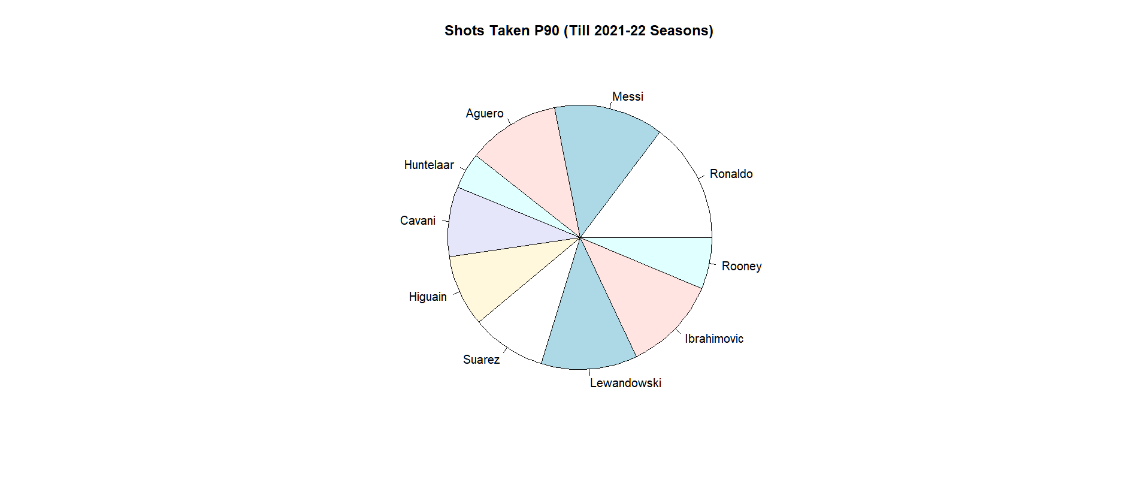
Shots Taken P90

Slide 15
Analysis
We see Ronaldo taking the most amount of shots in a match followed by Messi and Lewandowski.
Huntelaar has the least amount of shots in a match and from the data-set it is almost coming out to be 2 shots per match.

Slide 16
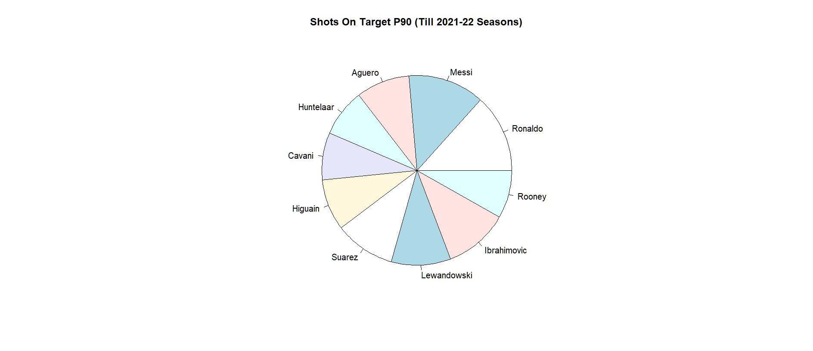
Shot On Target Per 90

Slide 17
Analysis
This stat tells us a bit about the amount of shot taken by a player per 90 with are on target whether it was saved by a goalkeeper or a defender or it went in the goal.
Ronaldo is puting a good volume of the shots taken on target which is why he has many goals as well. Same can be said about Messi as well.
Huntelaar here has the least amount of shots on target since he is only taking almost 2 shots in a game he plays. So he could only have at most 2 shot on target per 90.

Slide 18
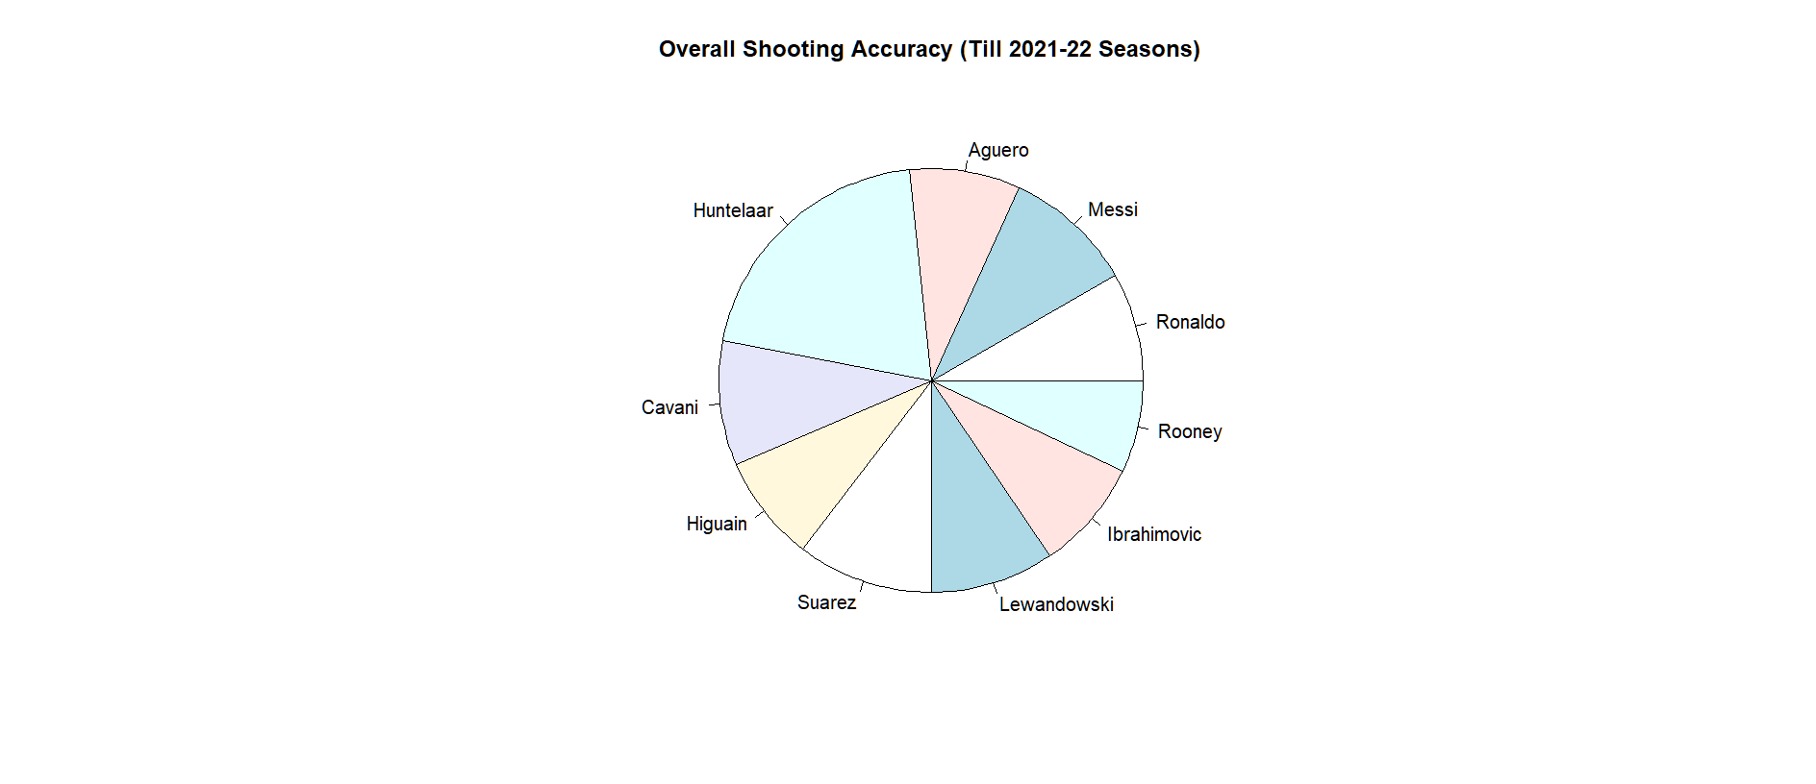
Shooting Accuracy

Slide 19
Analysis
This stat combined with Shots On Target per 90 tells us about the quality of the shot taken by a player the best.
Earlier we saw Ronaldo and Messi taking high volumes of shots in a match and put them on target but the average accuracy of those shots is very less.
Here we see Huntelaar having the best shooting accuracy, about 90 percent, so has the best shot efficiency since he only takes 1.72 shots per match and put them in the top corners which may well go in since they are harder to save.

Slide 20
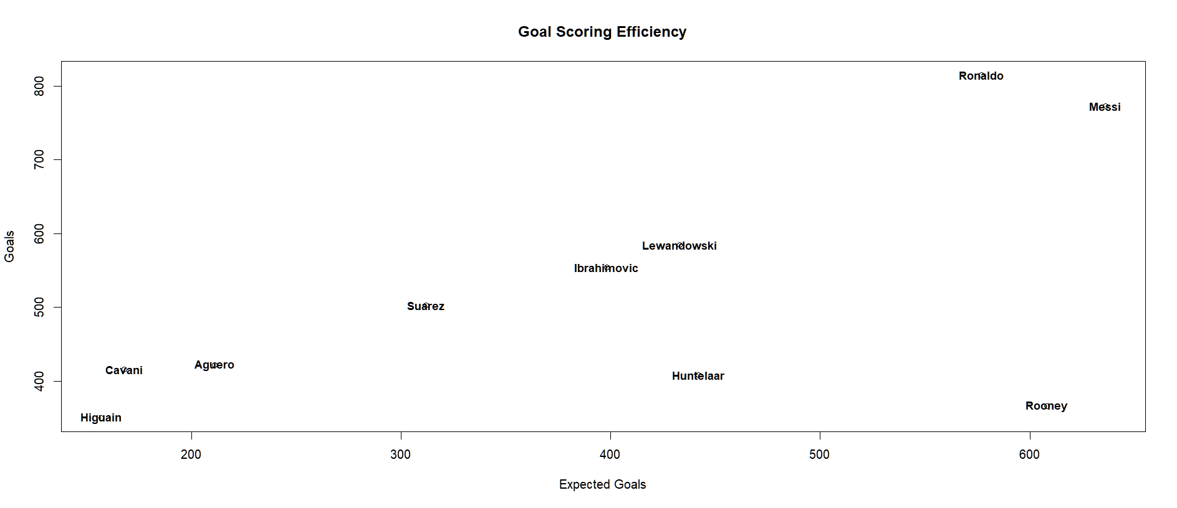
Goals Vs Expected Goals

Slide 21
Analysis
Goals vs Expected Goals tells us how much a player is outperforming from what is expected. For eg. a player getting a ball at almost at the corner point would have less chance or expected chance of scoring than a player getting the ball in front of the goal.
Here Ronaldo having the highest ratio means that either he has exceptional shooting or he has exceptional dribbling where he is scoring from a place where he is not really expected to score. Same can be said about Messi. It is pretty normal since they are wingers and they usually stay on the wing from where they least expected to score.
Higuain has the least since he is a striker and stays in the box where is very likely to score.

Slide 22
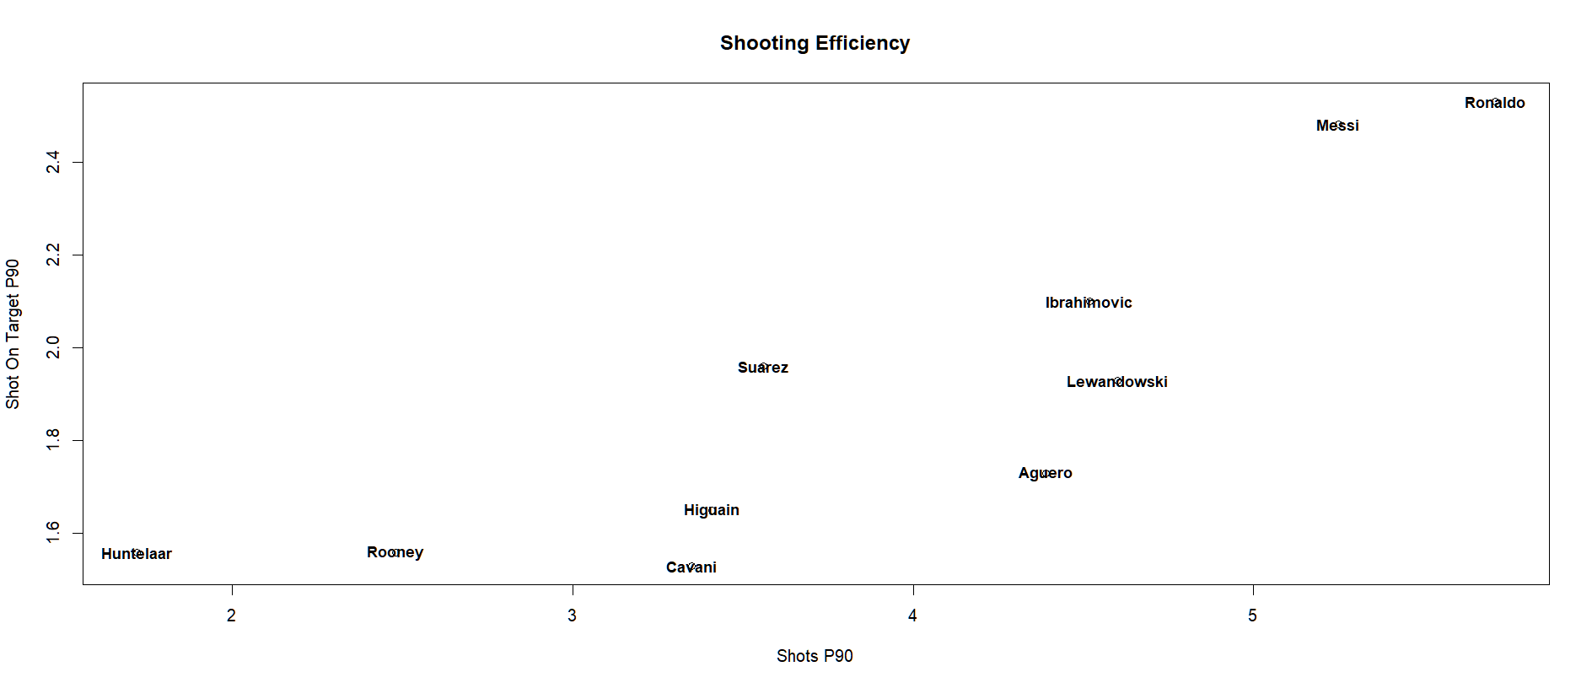
Shot P90 vs Shots On Target P90

Slide 23
Analysis
This stat combines Shots Taken per 90 and Shots On Target per 90 and tells us a bit about the efficiency of the shot taken by a player per 90.
Ronaldo is taking the most shots per match and puting a good volume of them on target which is why he has many goals as well. Same can be said about Messi as well.
Huntelaar here has the least amount of shots on target since he is only taking almost 2 shots in a game he plays. So he could only has less shot on target per 90.

Slide 24
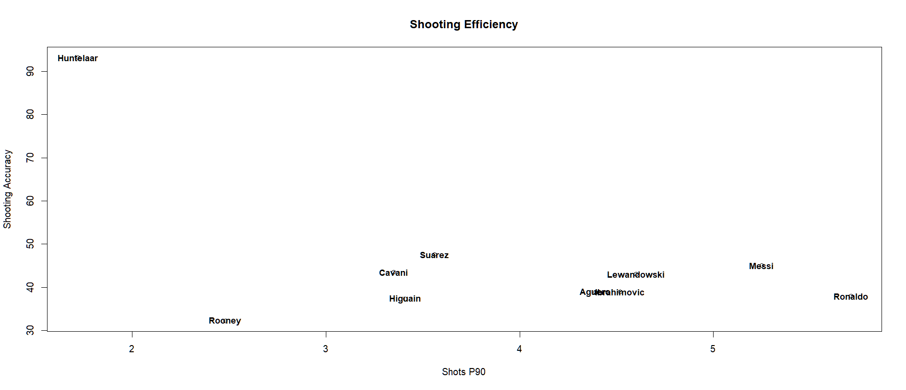
Shooting Accuracy vs Shots Per 90

Slide 25
Analysis
Here this chart better illustrates what was said earlier. Huntelaar has the best shooting efficiency since he takes very shots but putting them at the corners of the goal so it is harder to save them.
Rooney here can be seen having the worst shooting quality.

Slide 26
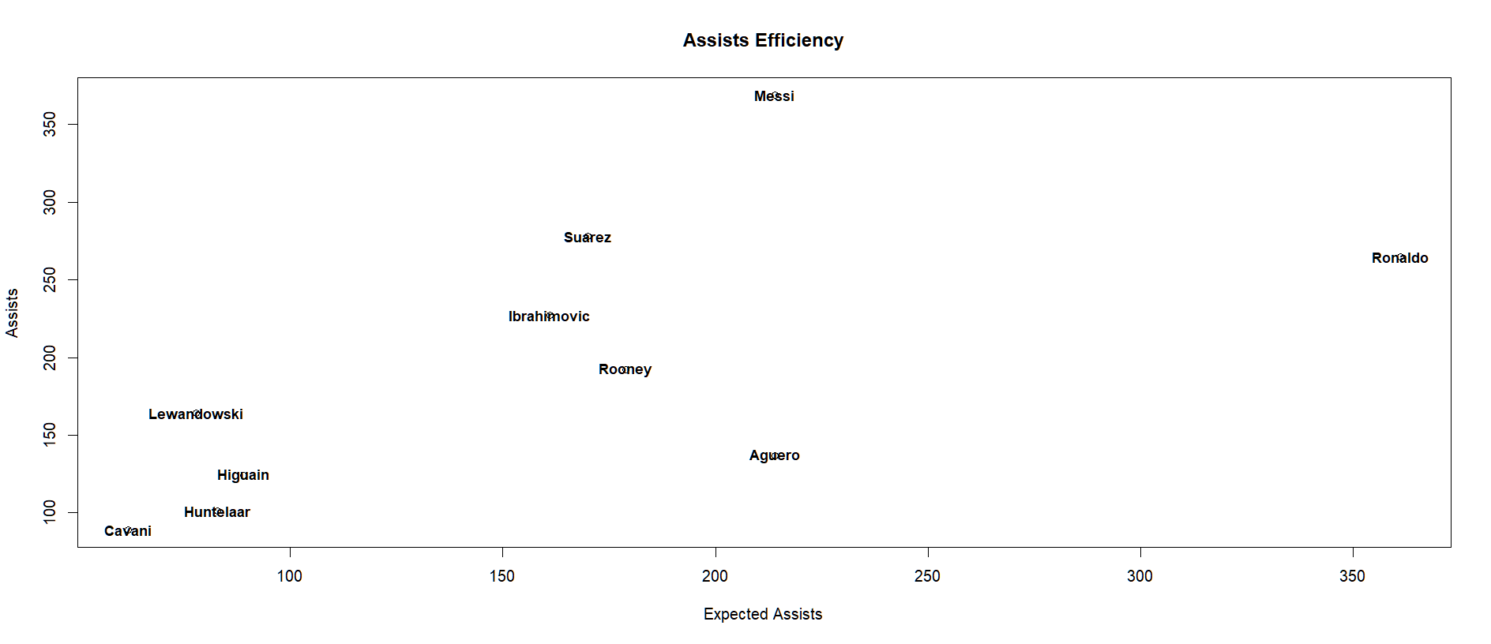
Assists Vs Expected Assists

Slide 27
Analysis
This chart showcases the playmaking quality of a player. A player towards the top left corner in the chart is a superior playmaker.
Here expected assists is the same as expected goals but a player on the wing or a midfielder will more likely to assist a goal than a striker.
Messi can be seen as a the most efficient playmaker since he assists more than what is expected. This showcases one of two things either he outperforms his passing ability or he has exceptional teammates who perform well individually.
Over the left bottom side we see all 4 players are proper strikers hence they are less expected to assists and more likely to score.

Slide 28
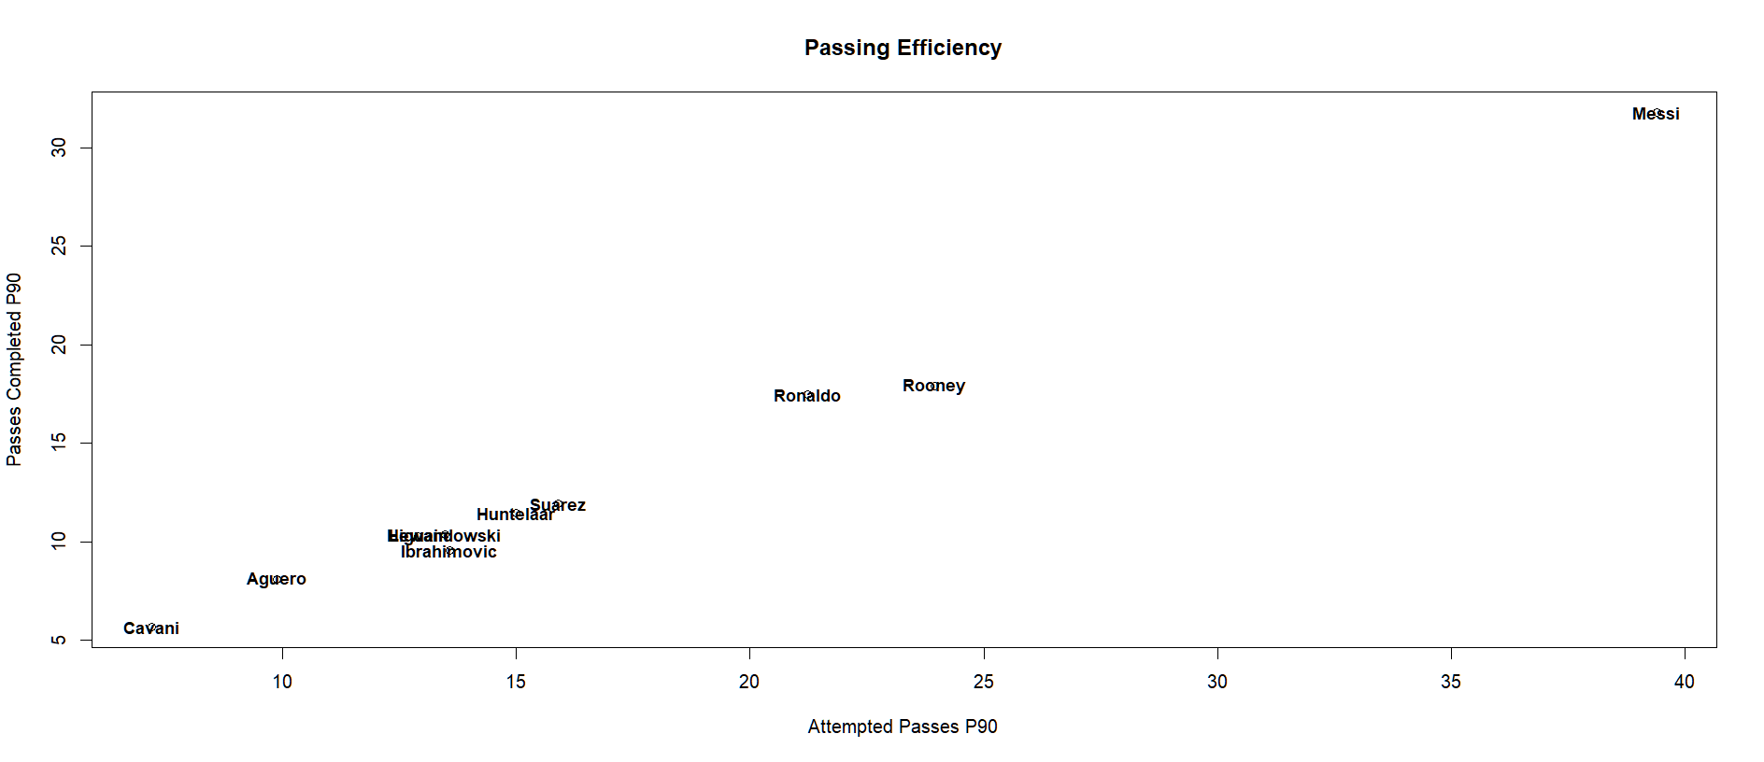
Attempted Passes P90 vs Passes Completed P90

Slide 29
Analysis
Here the chart shows the passing efficiency of a player.
Messi here can be seen in a league of his own. It is more impressive knowing he is a playmaker and is more likely to be failing his attempted passes.
Cavani is not really passing a lot which again showcases that he is a proper striker who stays around the box and shoots when he gets the ball.
But this stat can be increased if a player recieves a ball and passes it sideways or backwards all the time so,

Slide 30
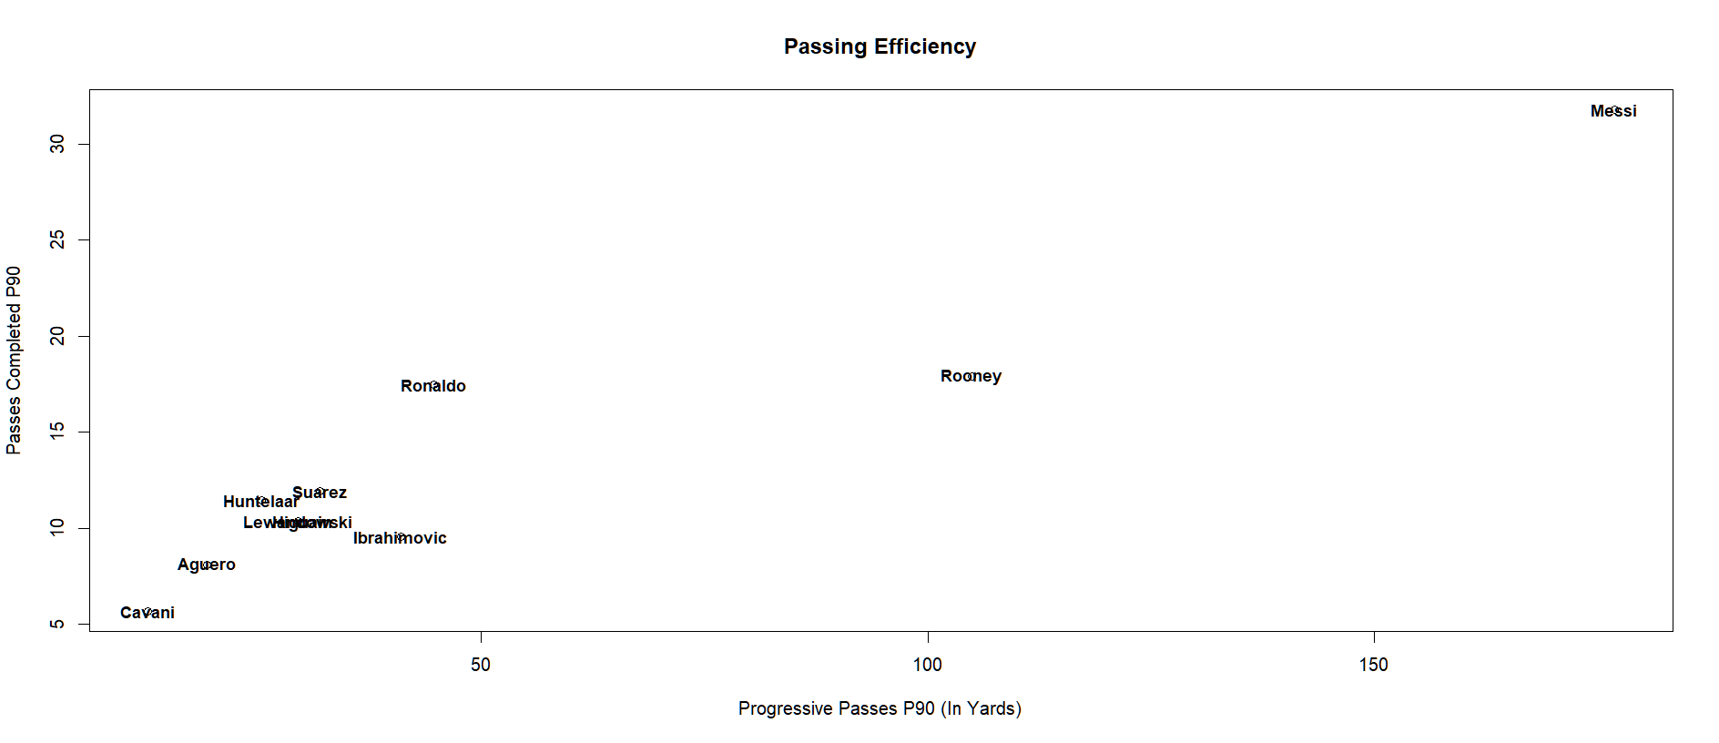
Passes Completed P90 vs Progressive Passes P90

Slide 31
Analysis
This helps understands the quality of a pass made by the player in a match.
Messi again stays in a league of his own league. This just showcases how good of a playmaker he really is because not only is he completing high volumes of passes, he is also progressing the ball high distances over the pitch. Rooney coming in at 2nd place. Not unexpected since he has the 3rd highest assists count in Premier League where he played most of his carrer.
Cavani here has the worst passing range since he is a striker and usually plays a quick one-two which does not progresses the ball much.

Slide 32
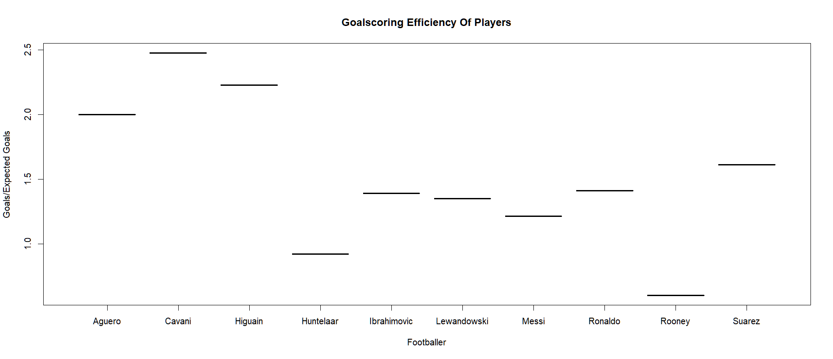
Goals/Expected Goal

Slide 33
Analysis
Here we see the goalscoring efficiency of a player from what is expected.
Here we see Cavani topping the chart for the reasons we discussed countless time. Here we see Ronaldo and Messi two wingers below almost all the strikers in the list since they are scoring what is expected and are in the box most of the time.
Rooney has the worst goalscoring ability out of all of them.

Slide 34
Modern Goalscorers
Now we are going to take a look at two fantastic youngsters - Erling Haaland and Kylian Mbappe - who right now are on the path of becoming top 2 players in the world.
We grew up among the rivalry of Cristiano Ronaldo and Lionel Messi who are one of the best players in the history of football.
So we are going to be comparing these youngsters to the G.O.A.T.S and see if they are upto the task of dethroning their rivalry.

Slide 35
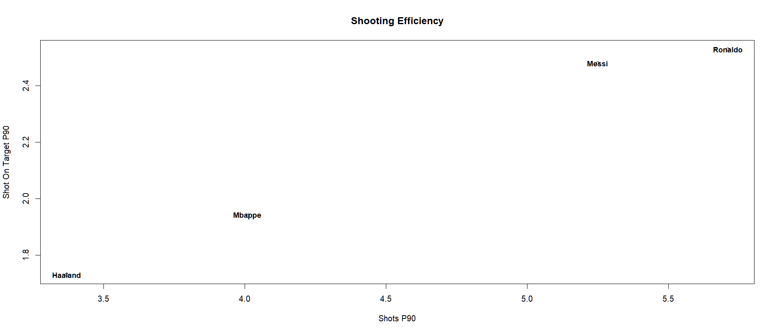
Shots Taken P90 vs Shots On Target P90

Slide 36
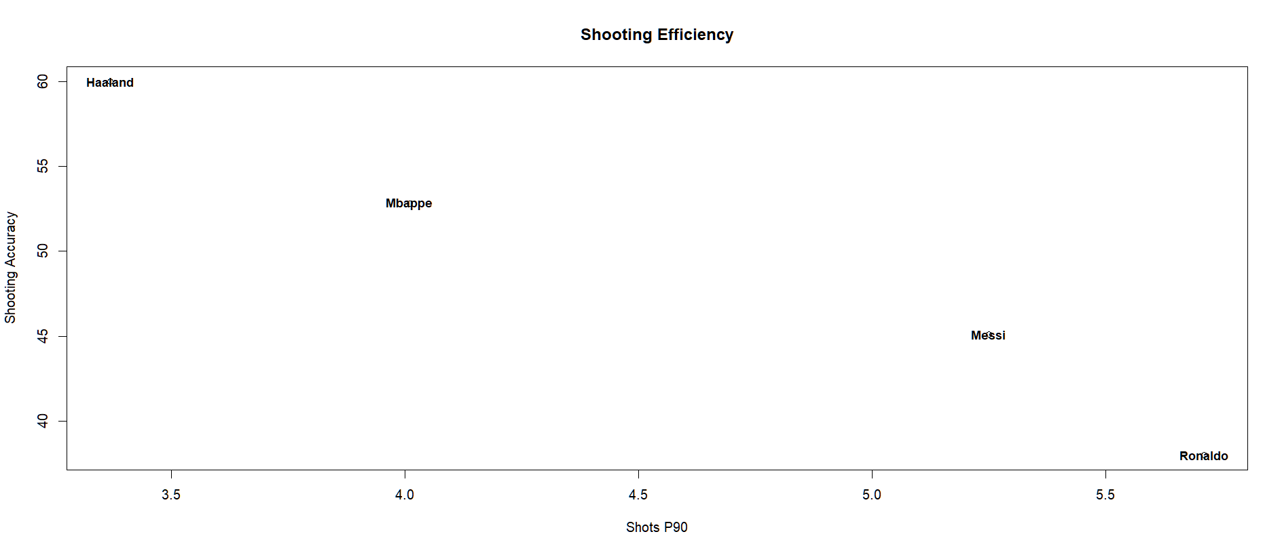
Shooting Accuracy vs Shots P90

Slide 37
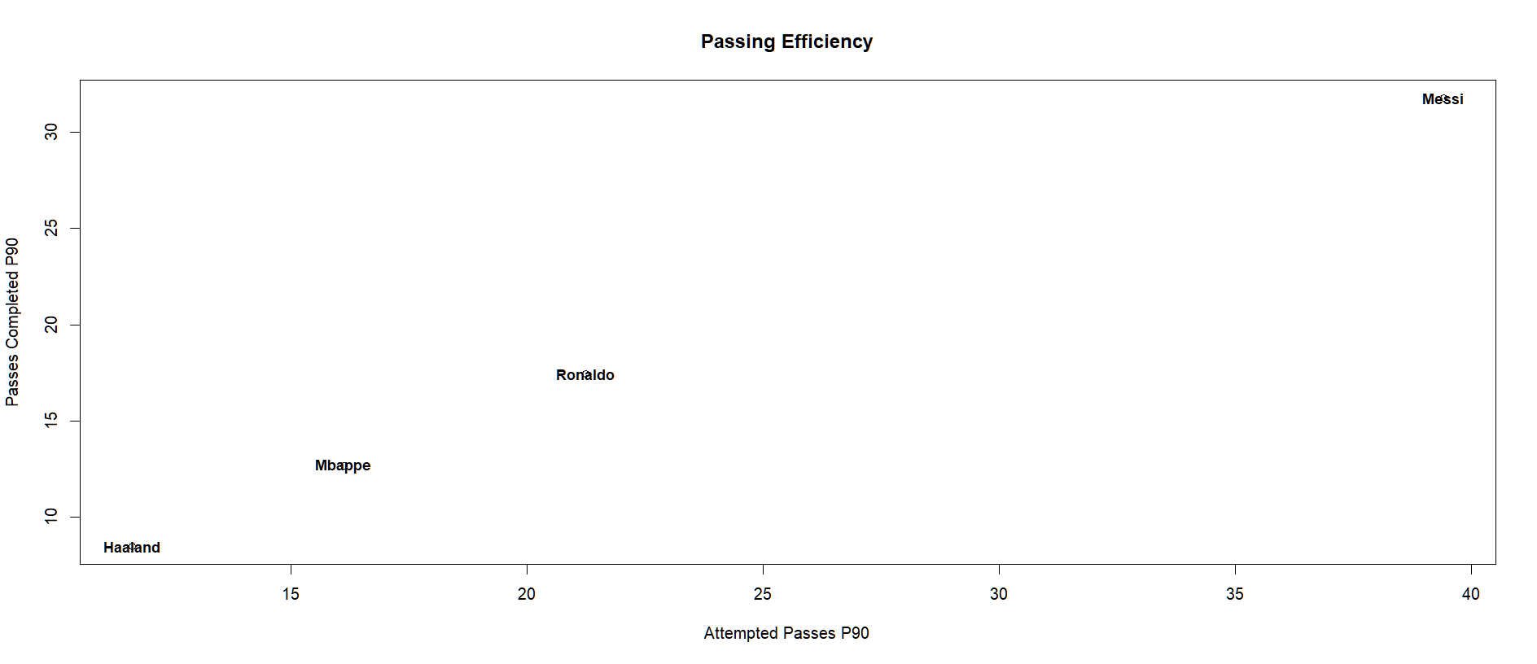
Attempted Passes P90 vs Passes Completed P90

Slide 38
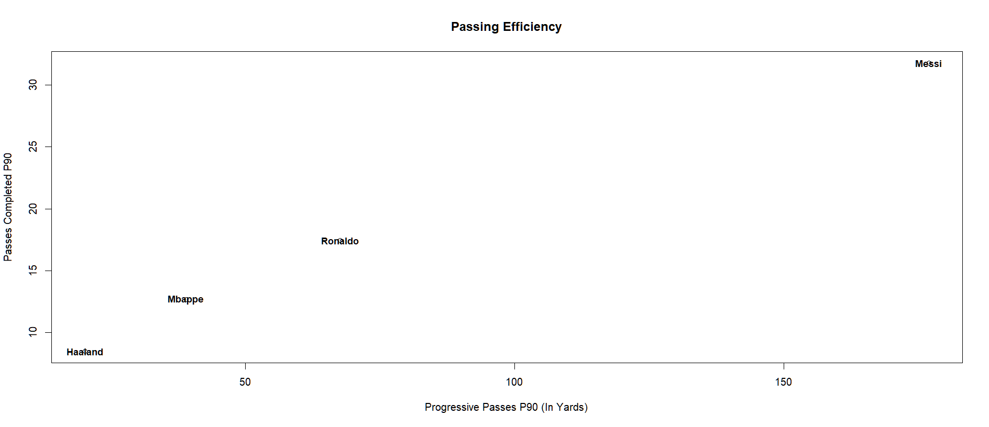
Passes Completed P90 vs Progressive Passes P90

Slide 39
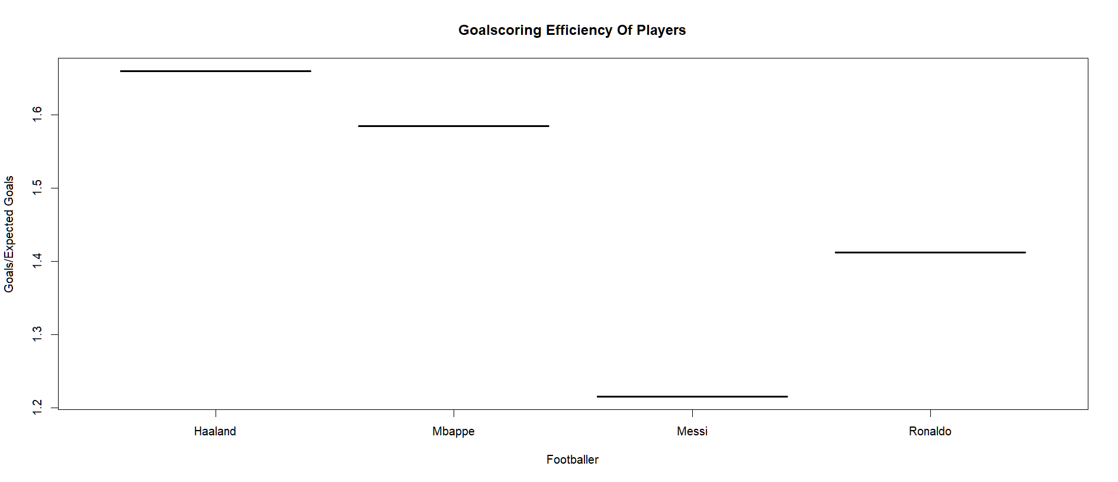
Goals/Expected Goal

Slide 40
Complete Analysis
Ronaldo and Messi have completely dominated the game for about 20 years. They have scored countless goals and gave many assists over the years.
We see Haaland and Mbappe not being able to completely overcome the GOATS potential.
But from the last chart it can be seen that if they continue and play till 35 years of age. They will outscore both of them but not beat them in the assists category or passes category.

Slide 41
THANK YOU For Listening
If you have any questions we’re happy to answer

